Slide 1

Hackathon #2
Group 2
Rojeen Shams
Bulat Farrakhov
Zacharias Georgiou
Georgios Halios

Slide 2








Roadmap
Observing the Data
Text Normalisation
Split Dataset
Stopwords
Tokenization
Lemmatization
Model Visualisation
INSIGHTS!
Create and Tune Model
Notes:
Observing Data: By observing the we were curious to see if there are differences in the requirements across states
Text Normalisation: Have the text normilise in order to pass it through the nlp pipeline. (lower cases etc)
Split Data: Given the availability of job descriptions for each states we decided to focus on CALIFORNIA, TEXAS, NEW YORK since they were the only states with a sufficient number of observations.
Expand on SpaCy’s Stopwords: were added to spacys stopword list
Tokenization:
Optimal Topic Number: We used coherence scores to choose the optimal topic number
Topic Modeling:
Insights:

Slide 3
Hypothesis
Over the recent years there has been a rise in labour migration from California to Texas, given the 0 state income tax and lower costs of living.
We wanted to check whether skills/requirements/job descriptions match between these two states.
Therefore we can make a conclusion that Californians are more prone to leave since Texas jobs ask for the same set of skills.

Slide 4
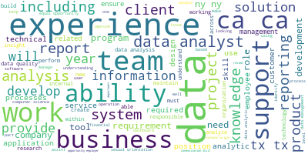
Stopwords
Notes:
Based on the context, it was decided that the stopwords needed extra attention.
Words removed were not necessarily the most frequent ones but the ones that don’t provide useful information given the context at hand.
Some of the words were added were ‘including’ , ‘reporting’, ‘work’ , ‘ability’, ‘employ’, ‘application’

Slide 5
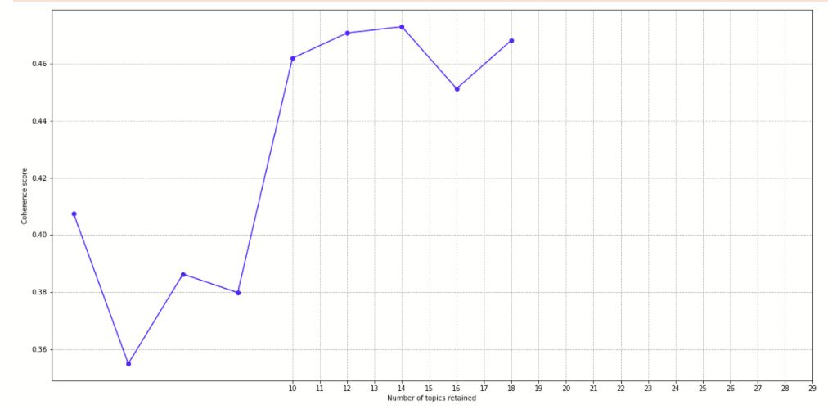
Topic Number Selection
Coherence Scores Vs Number of Topics for New York
Notes:
We did the same for the other two states and we got
Texas 10 topics
California 12
Lets take a glimpse at our interactive visualisation of New York.
We will explain how we label our topics

Slide 6
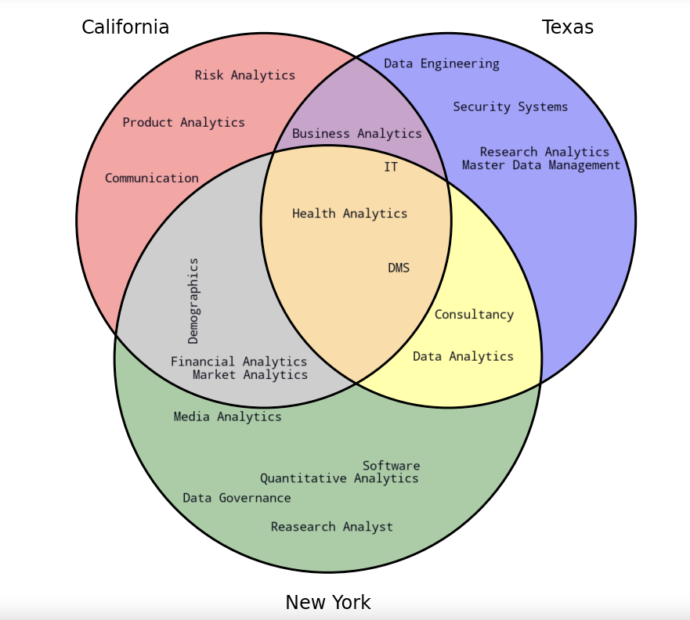
Notes:
New York had some interesting topics. Lot of job opening from child companies of Walt Disney. Such as Disney+ and Motion Pictures
Special reference to excel requirement for Financial Analysts.
Most of health analytics positions are dominated by mount sinai which is an integrated health care system.
General picture is that California jobs ask for analyst in different fields.
California job descriptions ask for soft skills.
They are mentioning that candidates will not be exposed to discriminations.
Texas seems to ask more for data management skills and I.T. skills rather than analytics.
California and New York have been into analytics for years and they share common skill requirements.
Given the recent rise in labour migration from California to Texas we can observe that there are not as many skills requirements in common.
We can assume that Texas is still developing in the analytics sector
In order to confirm this we need longitudinal data to observe the evolution of the skills requirements in Texas
We expect that over the next few years California and Texas will have even more skill requirements in common.

Slide 7

Thank you for listening
We will be happy to answer questions!

